Slide 1
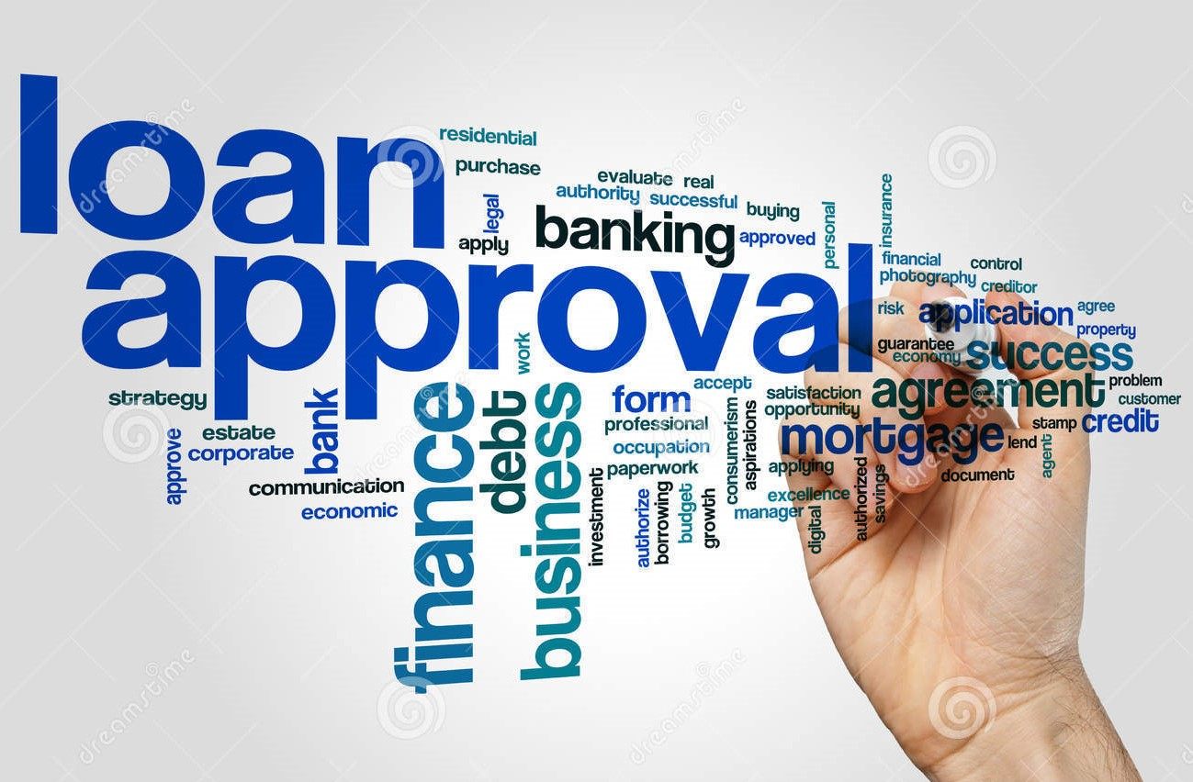

Slide 2
LOAN APPROVAL PREDICTION USING
MACHINE LEARNING
( DETAILED PROJECT REPORT)
--BY MANGESH SHINDE

Slide 3
ABSTRACT
Banks rely on loans for a significant portion of their profits, but it can be difficult to determine which applicants are likely to repay the loan. To address this, a loan prediction system using machine learning is being developed to automate the selection of qualified candidates. This will save time for both the bank and the applicant, and reduce the time it takes to approve loans. The system will predict whether a loan will be approved for a particular customer based on their gender, marital status, education, income, credit history, and other details. By automating the process, eligible customer segments can be identified and targeted specifically.

Slide 4
INTRODUCTION
Lending loans is a crucial part of banking and a major source of profit. The loan approval process involves verification and testimonial, but there is still uncertainty about whether the chosen candidate is suitable. Manual loan processing takes a lot of time, which is why loan prediction is helpful for both banks and applicants. The goal of this project is to quickly identify deserving applicants. The loan prediction system automatically calculates the weight of each feature and processes new test data with reference to the associated weight. A limit is set for the applicant to check if their loan is approved. Loan status updates are sent to various departments within the bank to choose eligible candidates.

Slide 5
MODULE 1:
DATA HANDLING:
The quantity & quality of your data dictate the accuracy of our machine learning model.
The outcome of this module is usually a representation of information which we are going to use for training.
The test and train dataset contains information about Loan Applicants. There are 12independent columns and 1 dependent column. This dataset includes attributes like Loan ID, gender, marital status, the level of education, applicant’s income etc.
MODULE 2:
PRE- PROCESSING PHASE:
Cleaning can require to remove duplicates, correct errors, deal with missing values, Normalization, data type conversions and so on.
We randomize data, which erases the consequences of the particular order in which we collected and/or otherwise prepared our data.
Pre processing is used to remove all the lower case, symbols, names, spaces etc. for example any word goes through pre-processing stage and after this word will be processed and converted into English.
All the NA and Null values are removed.

Slide 6
MODULE 3:
Selecting Model to train the data : Support Vector Machine : In this method, each data item is plotted in an n-dimensional space, where n represents the number of features, and each feature is represented by a set of coordinates. A hyperplane is chosen to distinguish the classes (possibly two) based on their characteristics . All the data that is required to predict loan status is trained applying SVM using the libraries imported.
Naive Bayes : Naive Bayes is a probabilistic algorithm, where the conditional probability is determined regarding the input features. On the other hand, during the dependent input features scenario , conditional probability is calculated twice resulting in improper results. Hence, for better prediction results with respect to Naive Bayes model, independent input features are selected and processed . This predicts the status of granting a loan based on the probability whether the customer can repay the loan or not.
Decision Tree: A decision tree is a type of supervised education algorithm (with a pre-defined target variable) that is commonly used in category problems. In this approach, we divide the population or sample into two or more homogeneous sets (or sub-populations) based on the most significant splitter/differentiator in input variables . Here loan status is set as the pre-defined target variable and it is predicted based on the trained features.

Slide 7
MODULE 4:
Evaluating the predictions using trained model:
For evaluating the trained model , we use the following features :
Loan_ID - The ID number generated by the bank which is giving loan.
Gender - Whether the person taking loan is male or female.
Married - Whether the person is married or unmarried.
Dependents - Family members who stay with the person.
Education - Educational qualification of the person taking loan.
Self Employed - Whether the person is self-employed or not.
ApplicantIncome - The basic salary or income of the applicant per month.
CoapplicantIncome -The basic income or family members.
LoanAmount - The amount of loan for which loan is applied.
Loan_Amount_Term - How much time does the loan applicant take to pay the loan.11.
Credit History - Whether the loan applicant has taken loan previously from same bank
Property Area - This is about the area where the person stays ( Rural/Urban).
Target Feature - Loan Status - Loan granted or not (Y, N)

Slide 8
Advantages
1. Improved accuracy: Machine learning algorithms can analyze large amounts of data and identify patterns that humans may miss, leading to more accurate predictions of loan approval.
2. Increased efficiency: Machine learning can automate the loan approval process, reducing the need for manual review and speeding up the approval process.
3. Customized solutions: Machine learning algorithms can be tailored to specific lending criteria, allowing lenders to create customized solutions for borrowers.
4. Reduced risk of bias: By using objective data analysis, machine learning can help reduce the risk of bias in loan approvals.
5. Transparency: The use of machine learning algorithms can make it difficult to understand the decision-making process behind loan approvals.

Slide 9
Disadvantages
1. Limited explain ability: Lenders may find it difficult to explain their loan approval decisions to borrowers if they are based solely on machine learning algorithms.
2. Data accuracy issues: The accuracy of machine learning predictions is only as good as the data it is trained on. If the data is incomplete or inaccurate, the predictions may be similarly flawed.
3. Regulatory compliance: Lenders must ensure that their use of machine learning complies with all relevant regulations, including fair lending laws.

Slide 10
Drawback of Existing System
Checking details of all applicants consumes lot of time and efforts.
There is chances of human error may occur due checking all details manually.
There is possibility of assigning loan to ineligible applicant.

Slide 11
Operating Environment – Hardware and Software
Hardware:
Computer with minimum 8 GB RAM and a multi-core processor
Software:
Operating system: Windows, Linux, or macOS
Python programming language (preferably v3.0 or later)
Integrated Development Environment (IDE): Jupyter Notebook (Anaconda Distribution)

Slide 12
IMPLEMENTATION
ARCHITECTURE DIAGRAM
DATA FLOW DIAGRAM
ER DIAGRAM
SEQUENCE DIAGRAM
COLLABORATION DIAGRAM

Slide 13
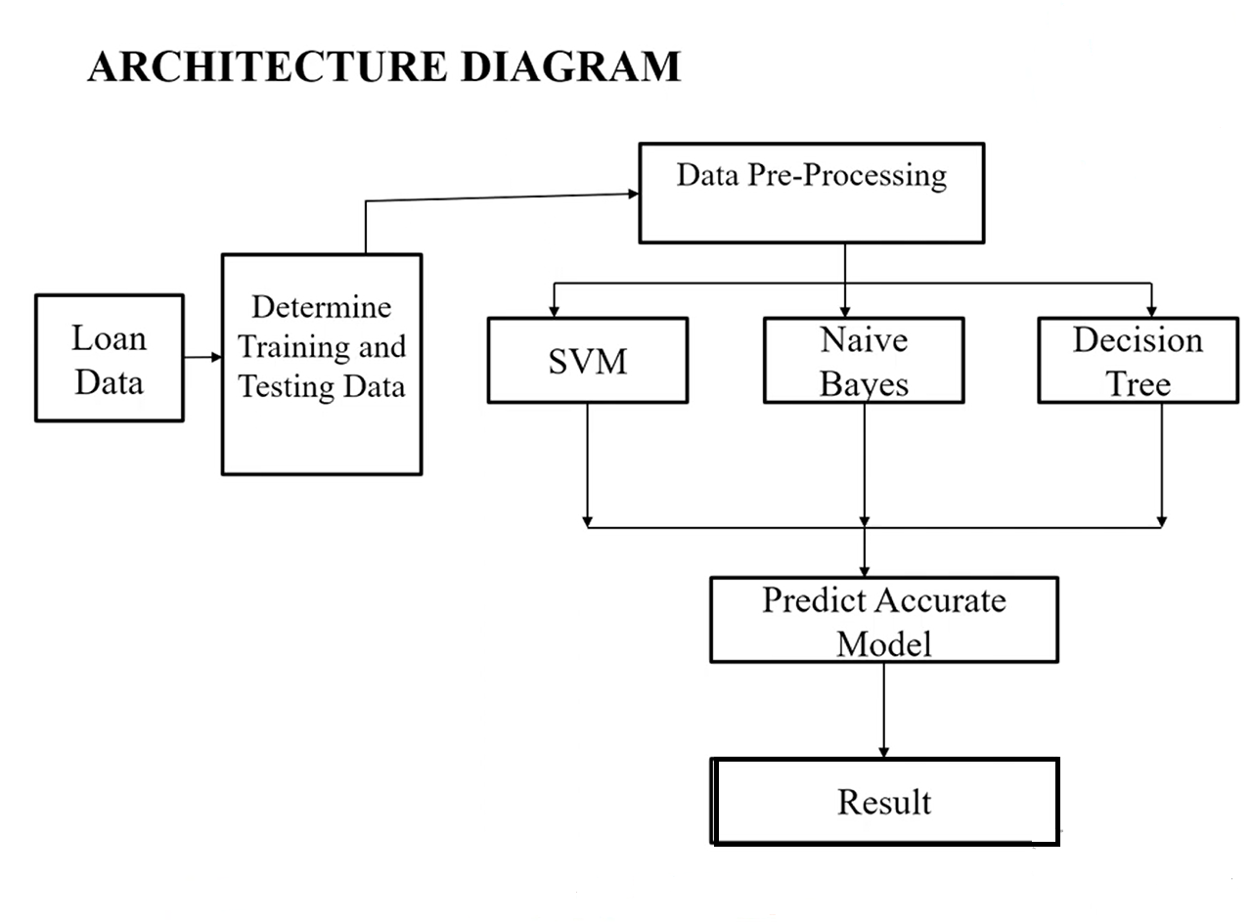

Slide 14
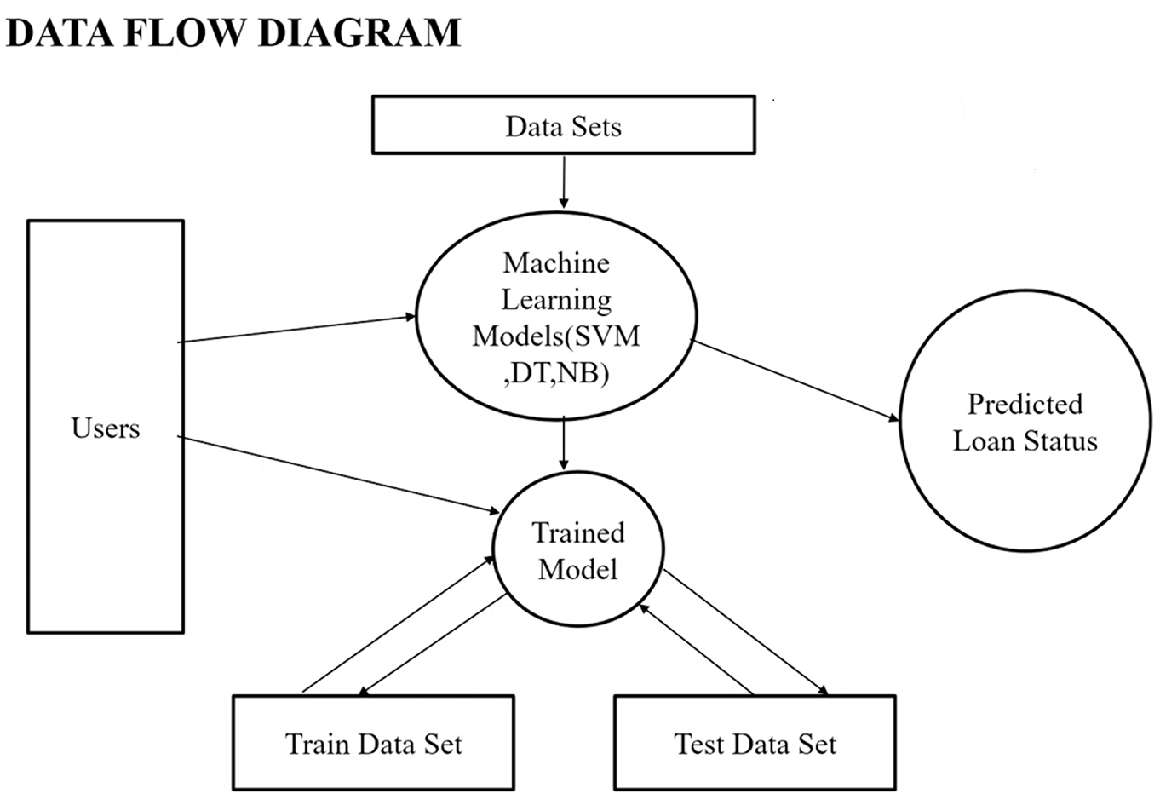

Slide 15
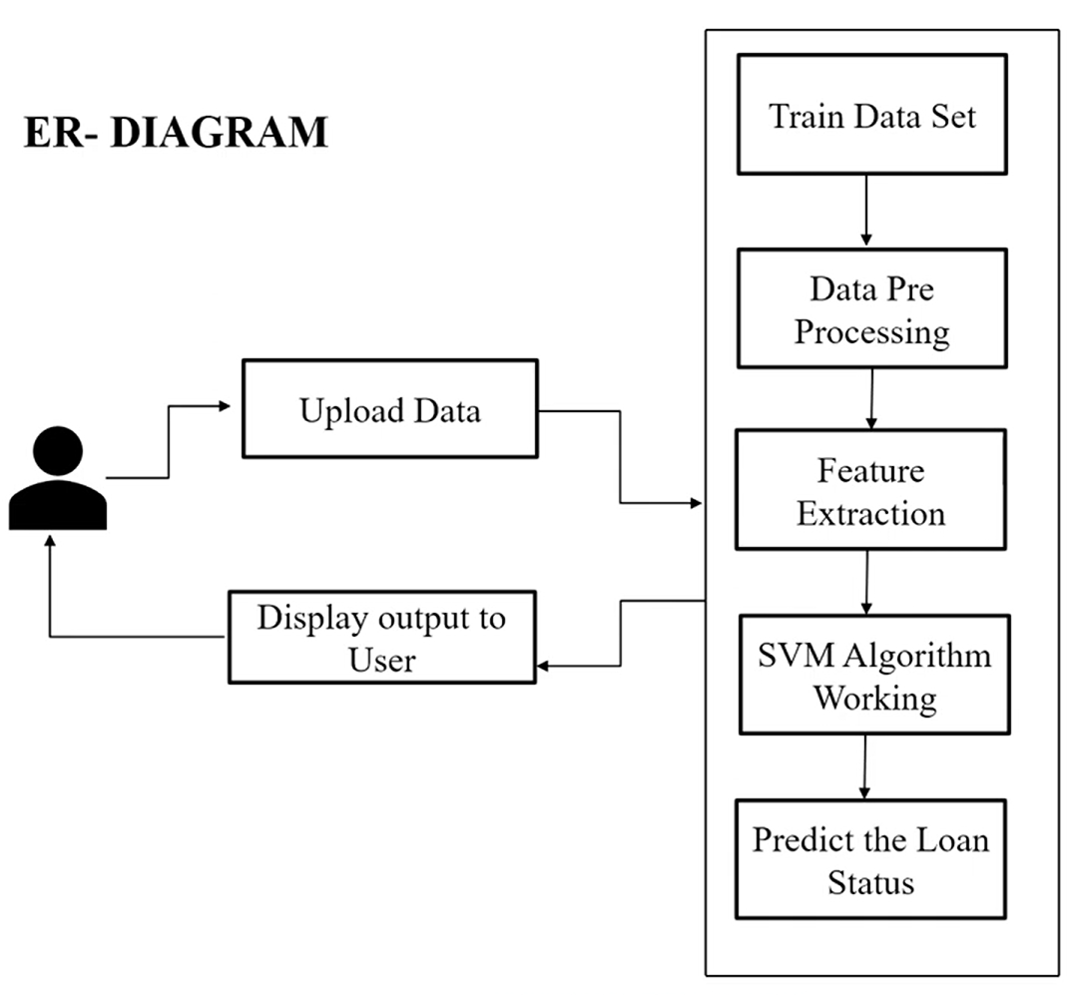

Slide 16
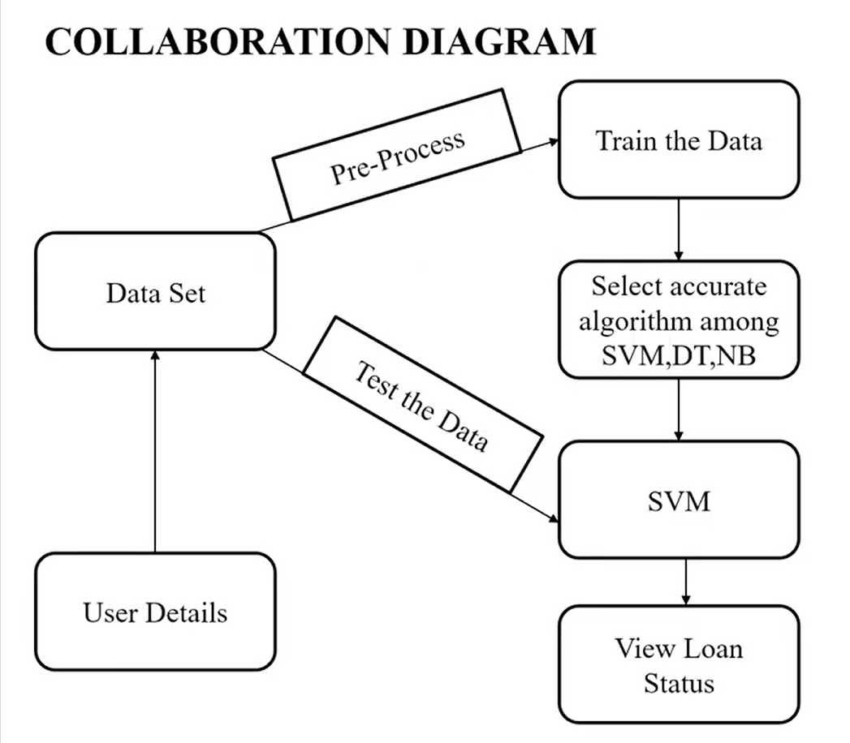

Slide 17
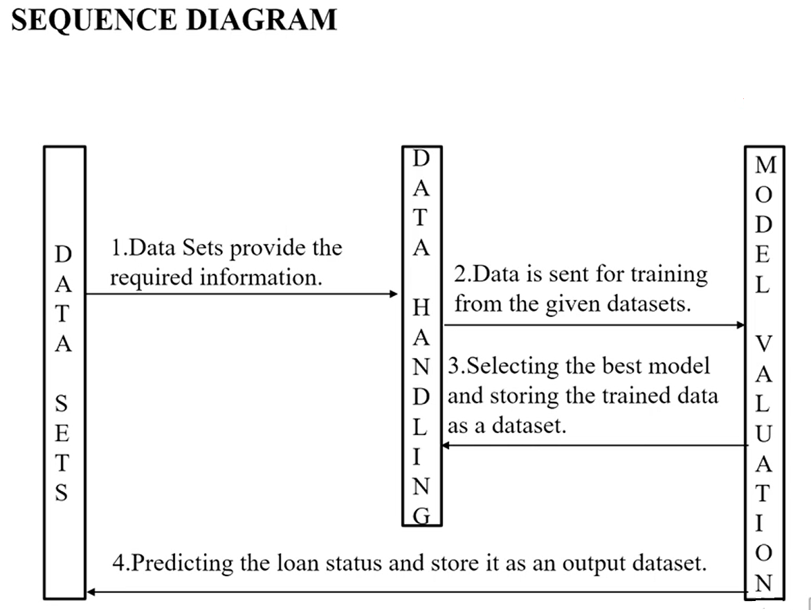

Slide 18
UNIT TESTING:
Unit testing is usually an automatic test that verifies each unit or, isolated piece of coding functions.
Unit tests are conducted individually, consisting of segments of code that work together to perform a selected function. Each unit test evaluates the coding written to confirm that it aligns with each said function.
The quality of unit tests depends on the ability to foresee and properly implement cases that should be within the test suite.
In this project, each machine learning model performs various functions like transform(), isnull() and other functions. All these functions can be tested individually and test it against the given data.
INTEGRATION TESTING:
Integration Testing is defined as a kind of testing where software modules are integrated logically and tested as a group.
Under Integration Testing all components that are developed are integrated and validated.
This project consists of multiple software modules like SVM ,Decision tree and Naïve Bayes.
The main purpose of integration testing is to combine modules within the application and test as a group to work out that they are working fine.

Slide 19
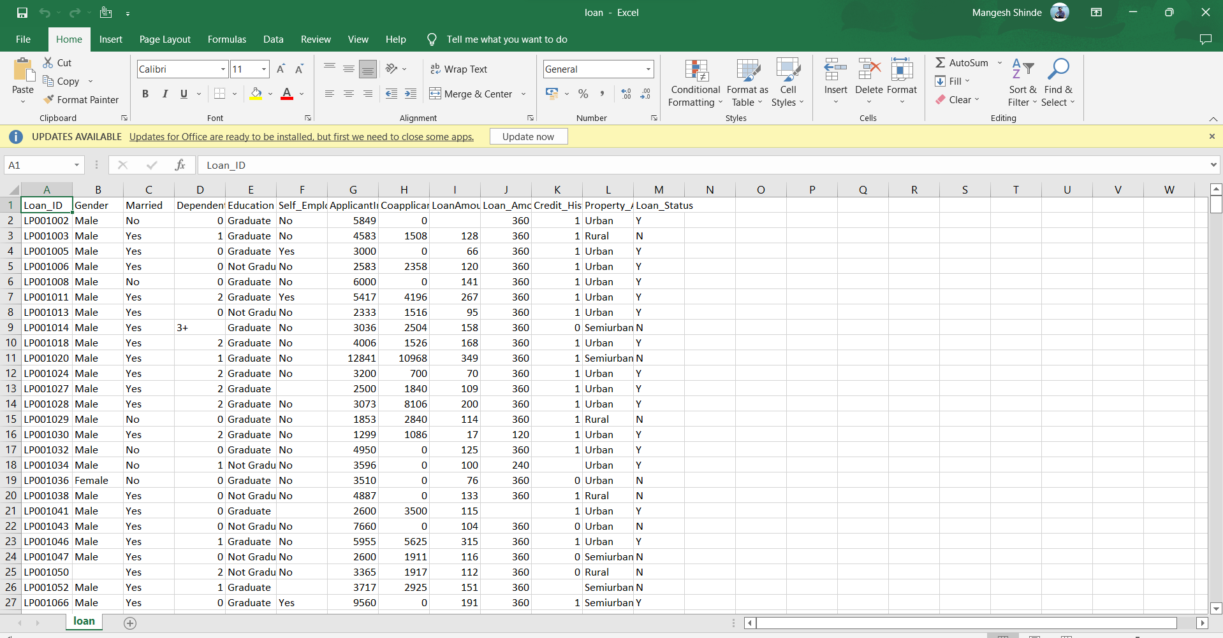
INPUT DATA SET

Slide 20
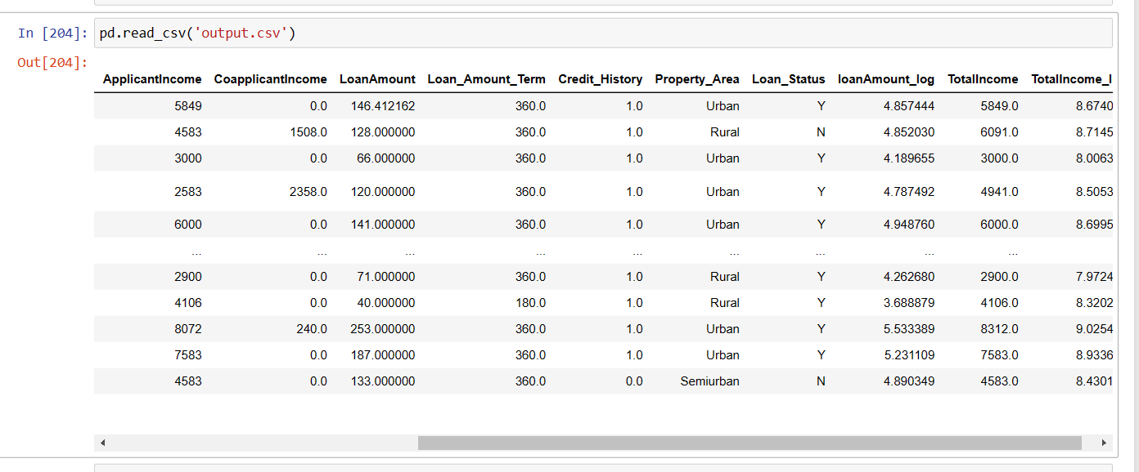
OUTPUT DATA SET

Slide 21
CONCLUSION
From a proper analysis of machine learning algorithms, it can be concluded that this system can be implemented in the real world banking systems to avoid conflicts while approving loans.
It can be concluded that Support Vector Machine , a supervised machine learning algorithm, has shown more precised accuracy among other algorithms at 73.17 % and hence can be used efficiently to solve banking problems.
Customer details can also be understood more clearly with this machine learning models.
Increase in the digital credit system requires more such techniques to make the banking sector more secure and trustworthy , so that a customer can avail a bank loan with less effort.

Slide 22
Future Enhancements
This project explores all the machine learning models and chose SVM among them with an accuracy of 73.17 % .
This can be used in evaluating risk based credit systems. This can further be improved by using different methods of feature selection which can produce much better and accurate results .
So further we can improve this model by combining different machine learning algorithms using different methods of ensembling like stacking , bagging and more.

Slide 23


